Slide 1
Data gathering & cleaning for Population Analysis of Desert Dace (Eremichthys acros)
Biol 792, Spring 2022
Madison Harris

Slide 2

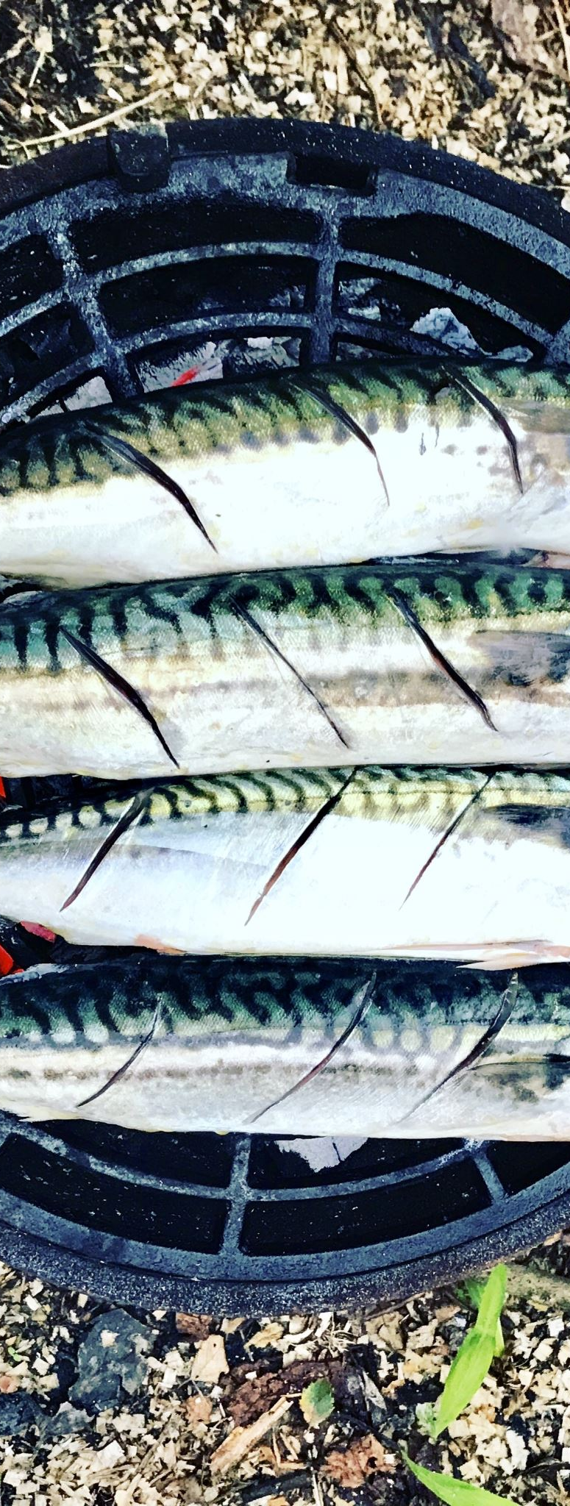
A few things before we get started… Terminology!
Cyprinid: Cyprinidae, a family of freshwater fish containing carps, minnows, and barbs.
Thermophilic/Thermophile: A type of organism that thrives at relatively high temperatures
Relict species: “Living fossils”, a species surviving since “ancient time” in isolated populations
Endorheic: a basin or lake that has no external outflow (river or ocean). Only loses water through the earth and evaporation
Notes:
Cyprinids: lots of small, freshwater aquarium fish

Slide 3
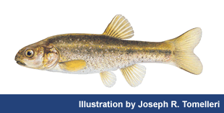
The Fish
A small species of thermophilic fish endemic to Soldier Meadows in Black Rock Desert
Found only within the ~6-9 outflows of local hot springs (distribution fluctuates as springs dry up)
Can withstand temperatures from 18-40.5°C (59-104°F), and have been observed to prefer 20-30°C.

Slide 4
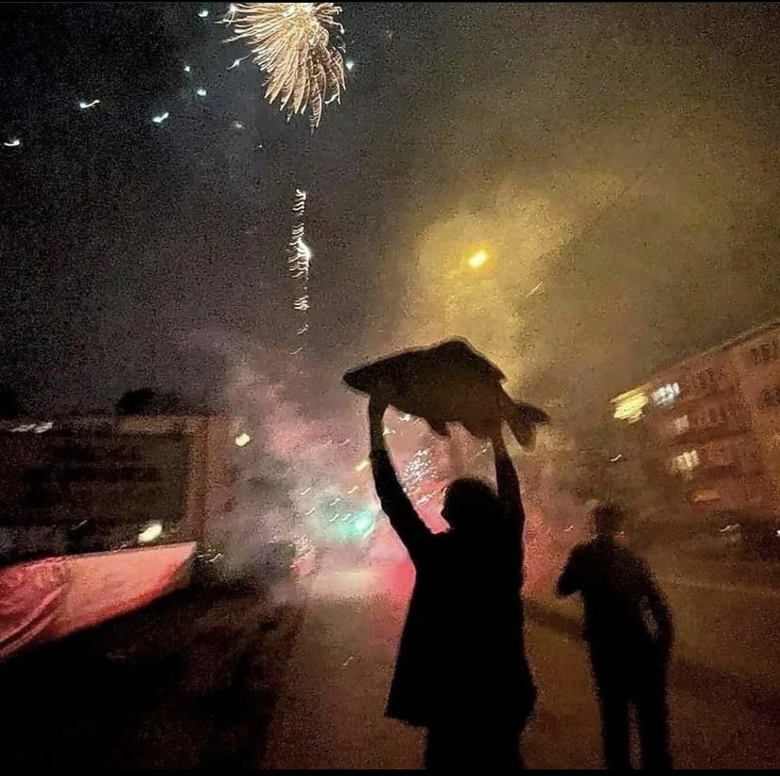
The Fish
A small species of thermophilic fish endemic to Soldier Meadows in Black Rock Desert
Found only within the ~6-9 outflows of local hot springs (distribution fluctuates as springs dry up)
Can withstand temperatures from 18-40.5°C (59-104°F), and have been observed to prefer 20-30°C.

Slide 5
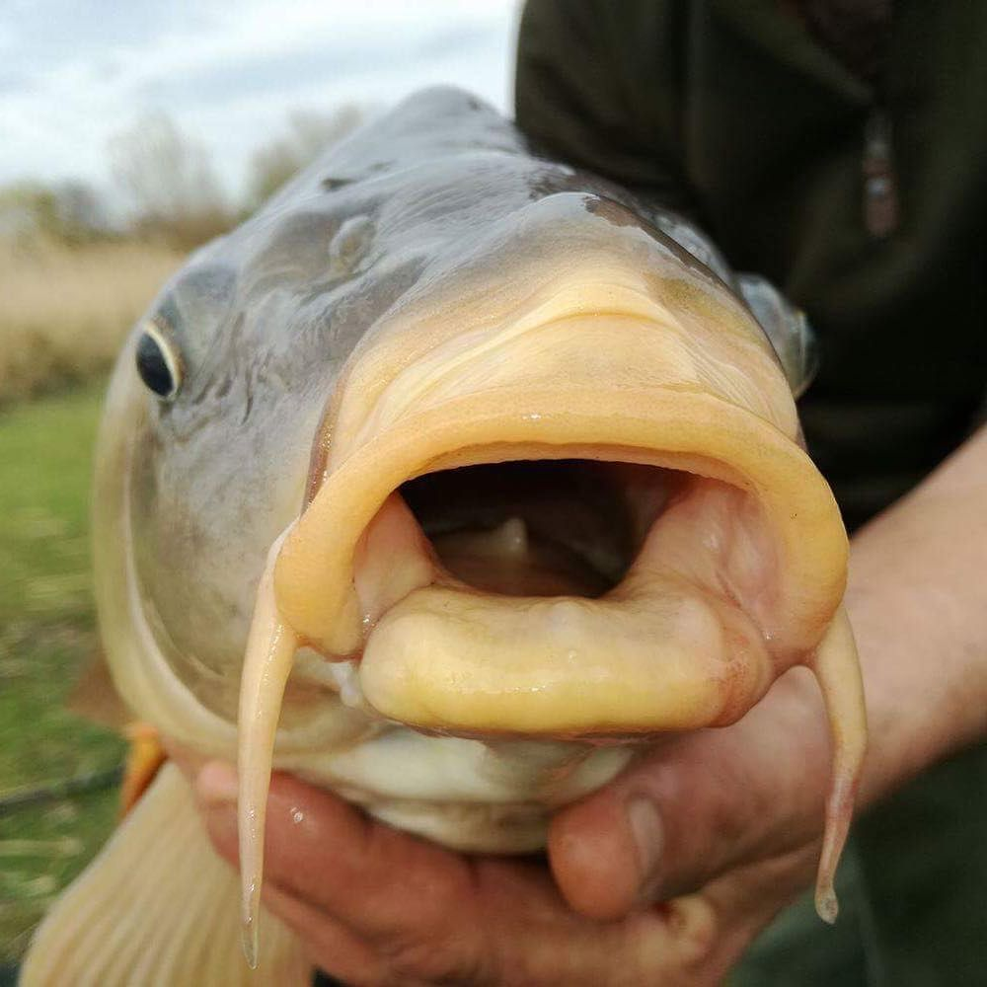
We know very little
Have been observed breeding and spawning THREE TIMES since discovery in 1948
Implies year-round spawning
Distribution overlaps with speckled dace (Rhinichthys osculus) in cooler waters.
Level of interaction and overlap is unknown (interbreeding, hybridization, and competition)
AND YET
Desert dace have been observed (in captivity) eating other fish, INCLUDING speckled dace

Slide 6
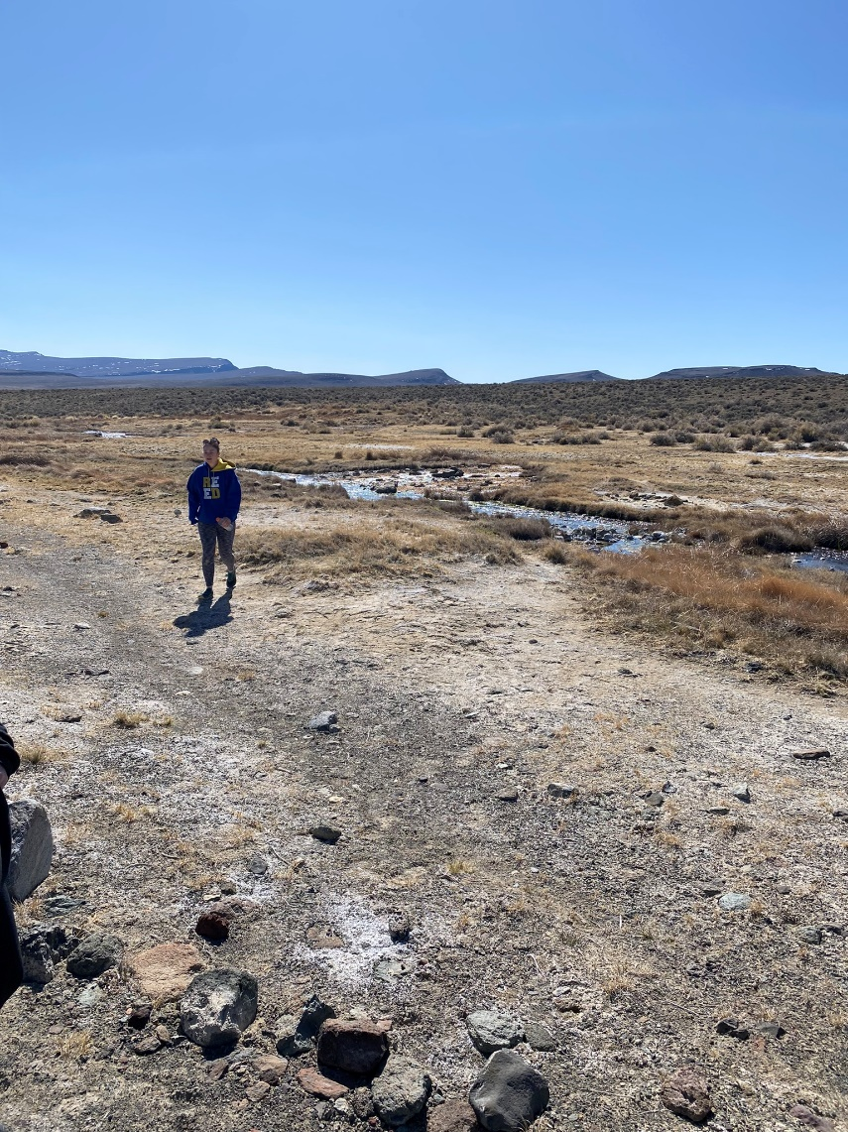
The Habitat
Soldier Meadows is a series of ~50 hot springs in northern Black Rock Desert
Left over from Lake Lahontan, an ancient Pleistocene endorheic lake that covered most of northwestern Nevada (~115,000 km²)
The Soldier Meadows hot springs (and desert dace) have been isolated for the last 10,000 years, at least
Long history of isolation, physical evidence of the area, and high levels of genetic diversity = relict species

Slide 7
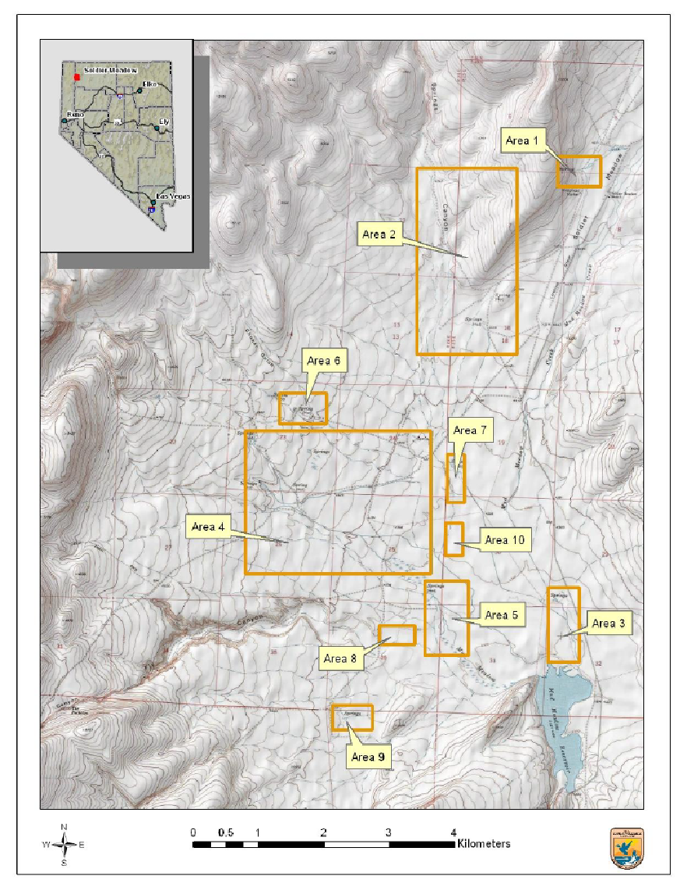
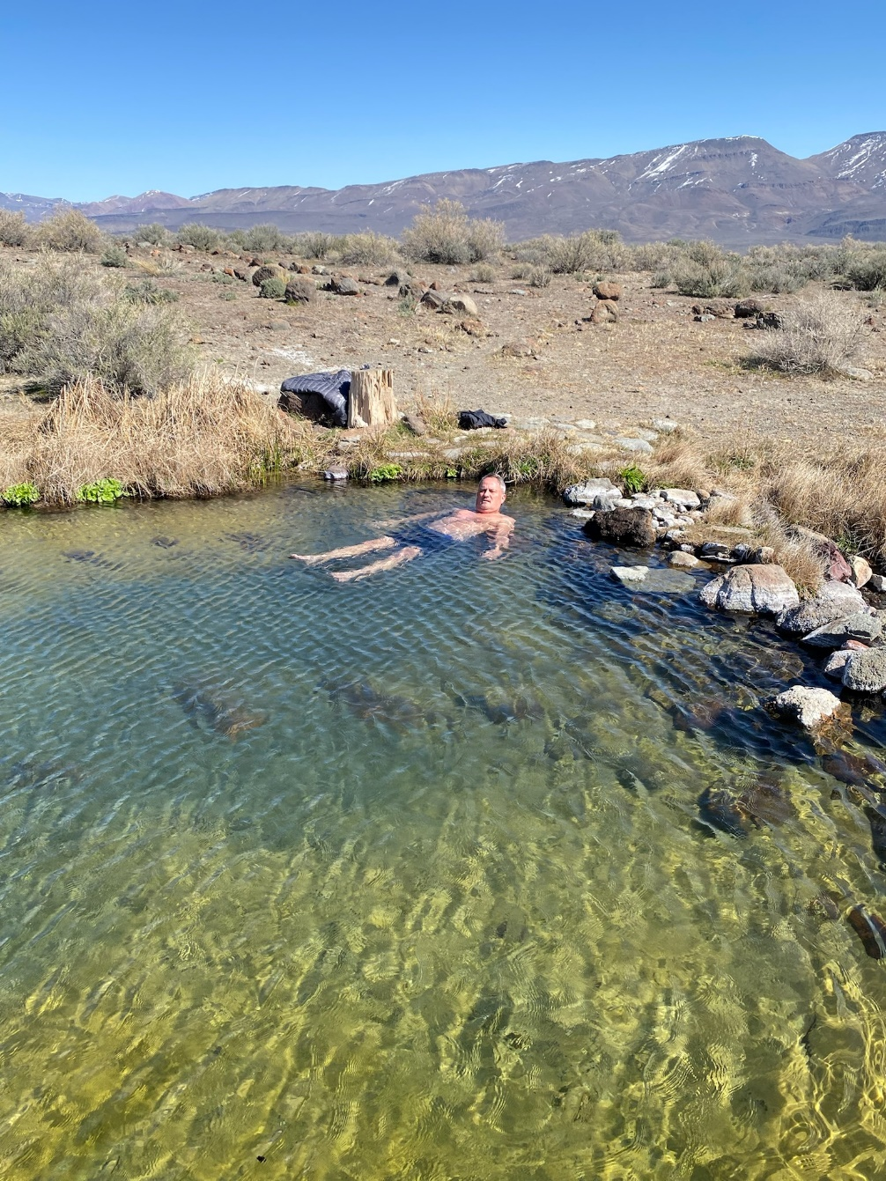

Slide 8
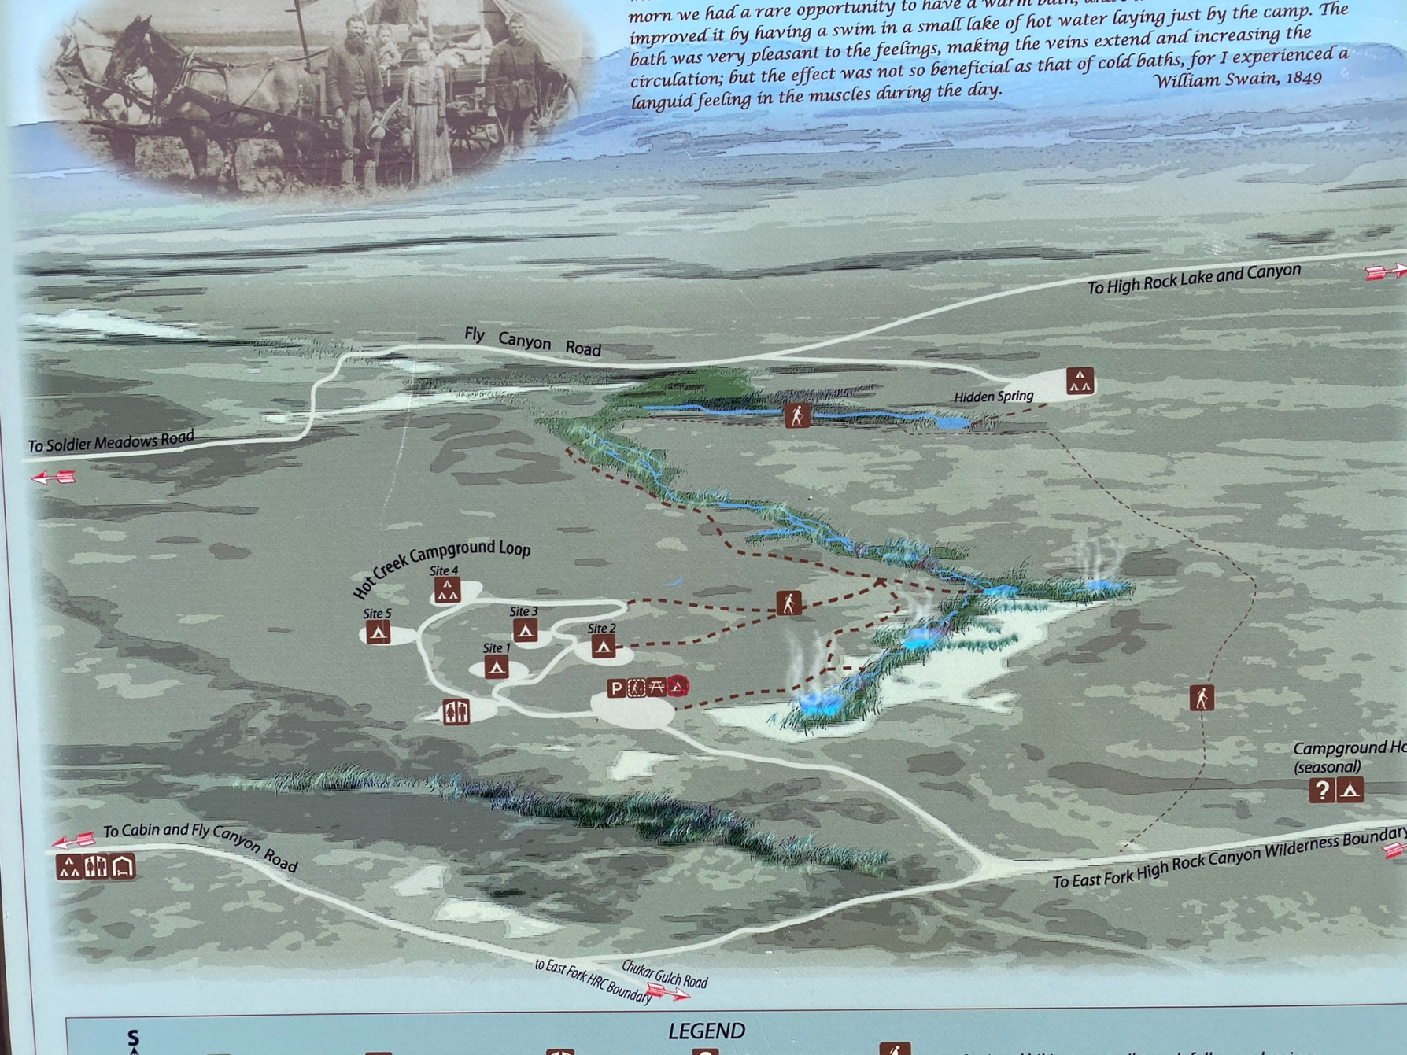

Slide 9




The Data, Pt 1
Types of data:
Sample_location files
USGS streamflow gauges
Programs & Methods used:
OpenRefine (clean-up)
JupyterNotebook → Pandas
Rstudio → package dataRetrieval

Slide 10
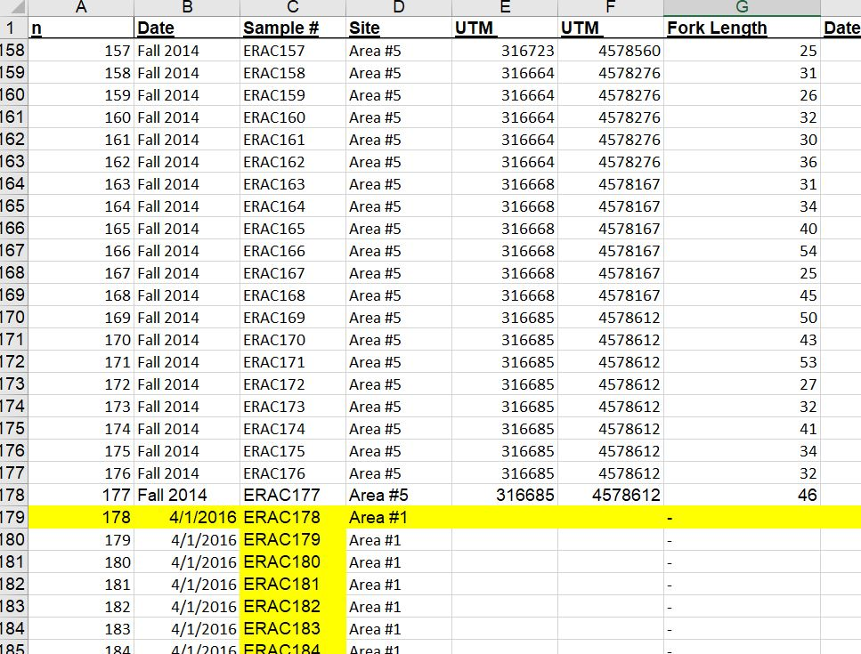
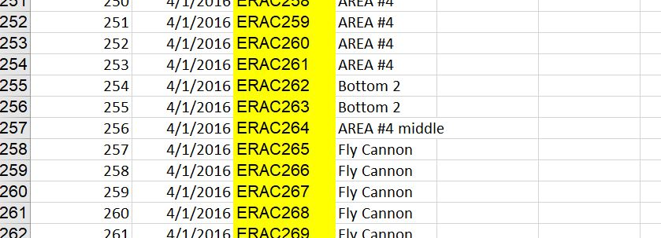
The Data, Pt 2 Sample files
The background:
Original 2 batch of fin clip samples were taken and recorded by a previous grad student. I’ve inherited his datafiles.
Here’s what I started with →

Slide 11
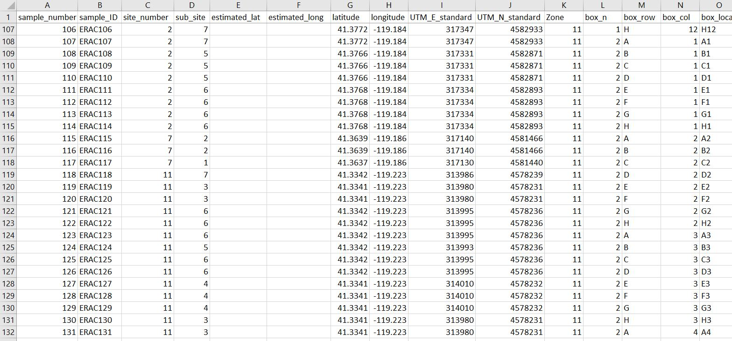
The Data, Pt 2 Sample files
What I’ve got now →
OpenRefine used to clean up lat/long (from conversion)
Fill missing location boxes
Fix incorrect locations
(ei: UTM E was written with a 4 instead of a 3, so the sample is in the middle of the Pacific ocean. Double-checked with Google Earth)

Slide 12
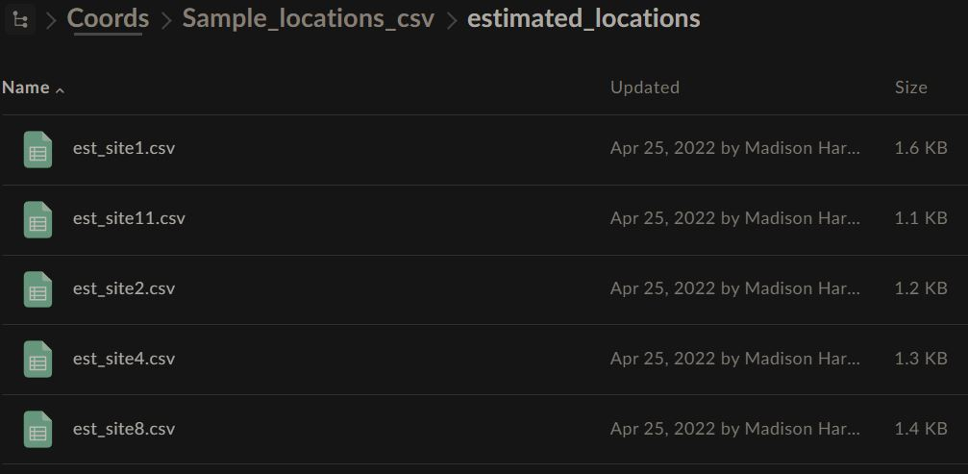
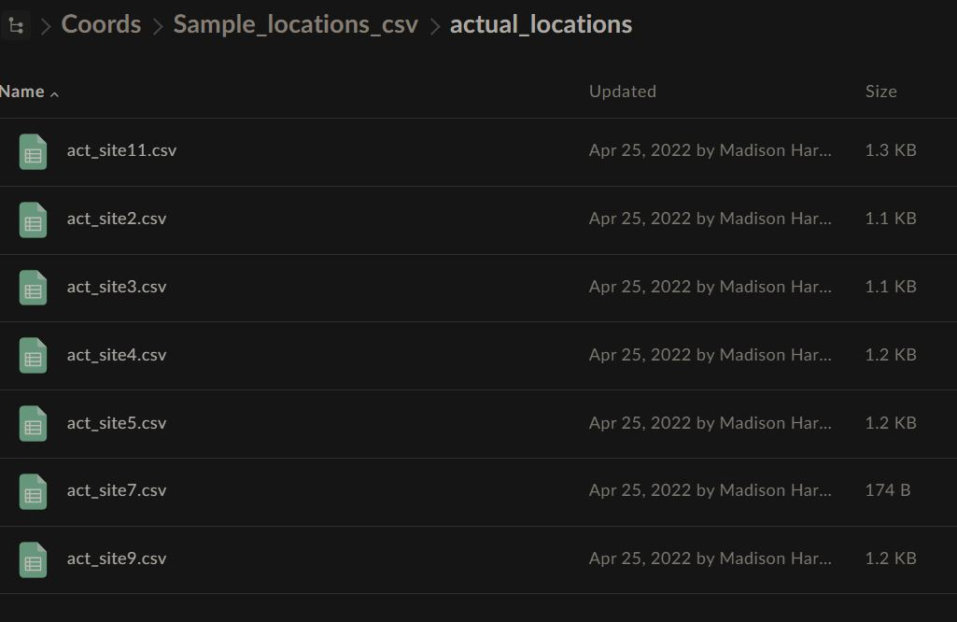

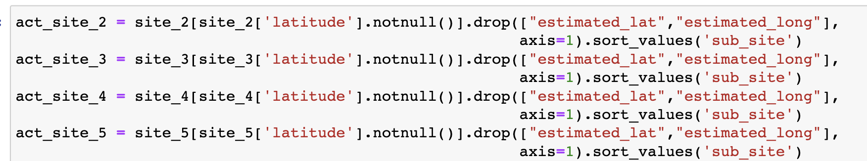

The Data, Pt 2 Sample files
☺
Split the main big file ↑ ↑ into two groups of smaller files, actual & estimated locations
Those groups were then broken down further into separate dataframes for each site.
Will be used for within-area predictions
Fish can’t really move that much (physically)
Used pandas & jupyter notebook

Slide 13
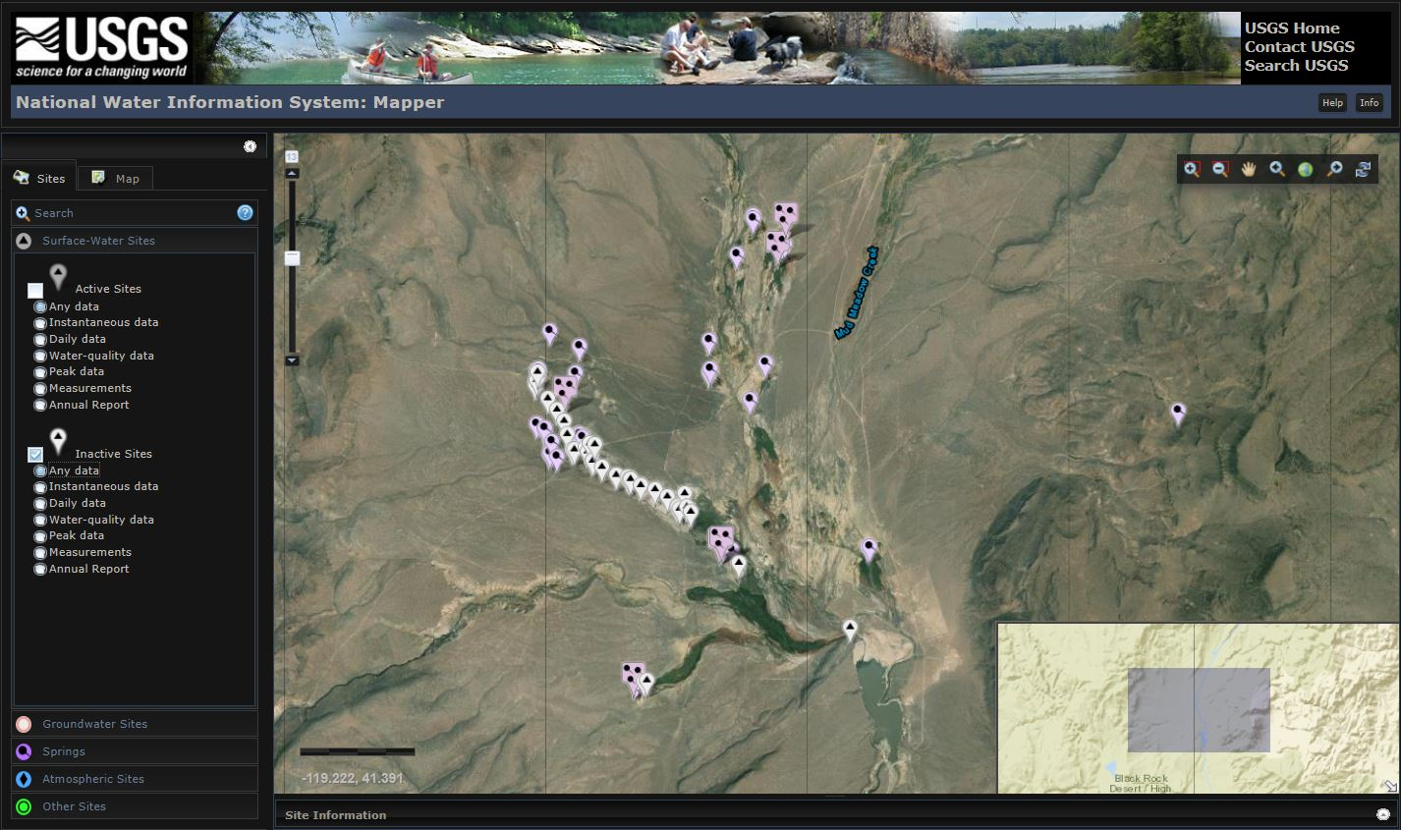
The Data, Pt 3 USGS streamflow gauges
https://maps.waterdata.usgs.gov/mapper/index.html

Slide 14
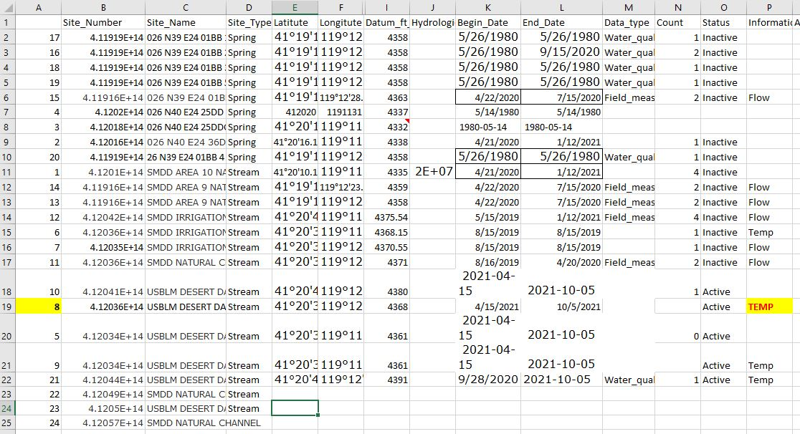
The Data, Pt 3 USGS streamflow gauges

Slide 15
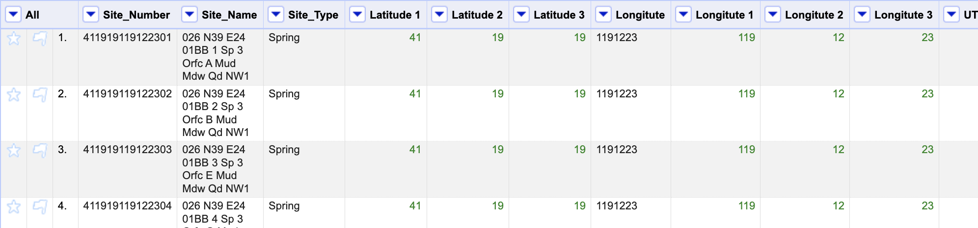
The Data, Pt 3 USGS streamflow gauges
Convert DMS to Decimal degrees: 41°19’19” → 41.32194444
OpenRefine & pandas
Remove special characters via transform
value.replace(/[^\u0020-\u007F]/,"")
value.replace("'", "")
value.replace('"', "")
2. Split columns according to field lengths (2,2,2) & (3,2,2)
3. Export to csv, then to pandas
Notes:
There are file-upload and copy-paste websites to do this, as well as excel formulas (not commands, just separate formulas). BUT: those file upload sites would’ve required me to copy-paste each individual coordinate pair into a new file to keep them together or do it piece-by-piece. This way, I can do this over and over with minimal work, once past the original effort to write the code

Slide 16



The Data, Pt 3 USGS streamflow gauges
Convert DMS to Decimal degrees: 41°19’19” → 41.32194444
OpenRefine & pandas
read-in the csv file
make a new column (latitude) whose values are a combination of the others
41 + (19/60) + (19/3600)
Repeat for longitude
3. Drop the unnecessary extra columns
Notes:
There are file-upload and copy-paste websites to do this, as well as excel formulas (not commands, just separate formulas). BUT: those file upload sites would’ve required me to copy-paste each individual coordinate pair into a new file to keep them together or do it piece-by-piece. This way, I can do this over and over with minimal work, once past the original effort to write the code
USGS likes to use DMS coordinates, but I’m trying to standardize my data by using degrees (less chance of it getting mixed up with something else, lower chance of error if miss typed).

Slide 17
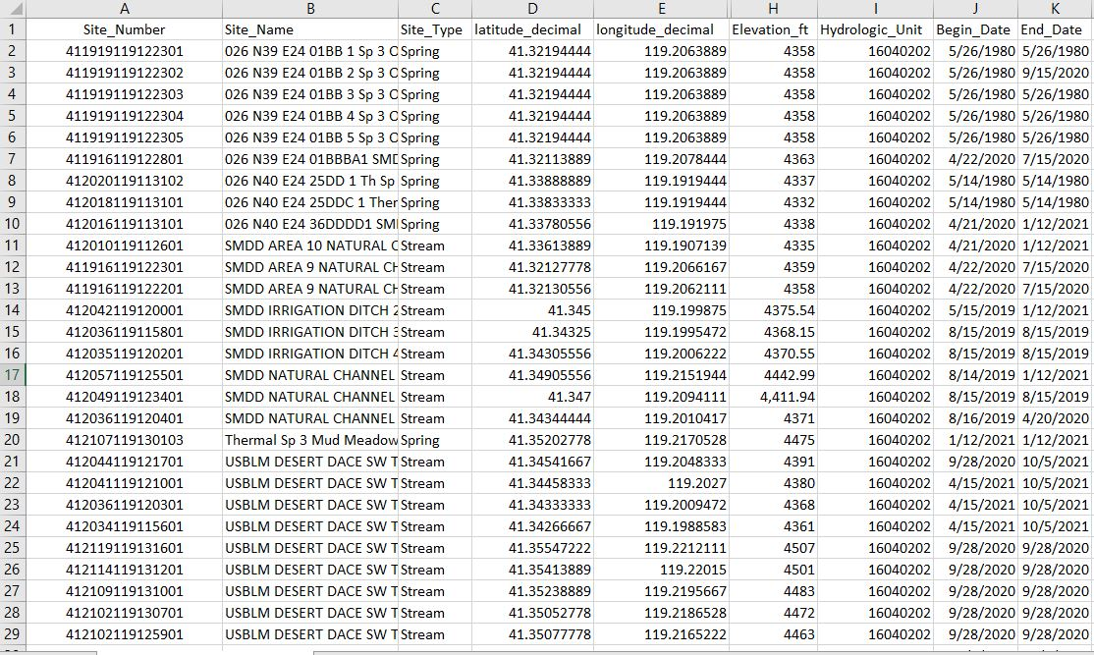
The Data, Pt 3 USGS streamflow gauges
Used OpenRefine to:
Remove “special characters” that python doesn’t like
Standardize the date, elevation and hydrological unit
Change site_number cell format
(Excel likes to turn a long string of exact numbers to an exponential and therefore remove precise values)
Notes:
I can now take this nice, cleaned-up file and split it up, organize it, sort it, whatever I need to to use with the USGS website

Slide 18
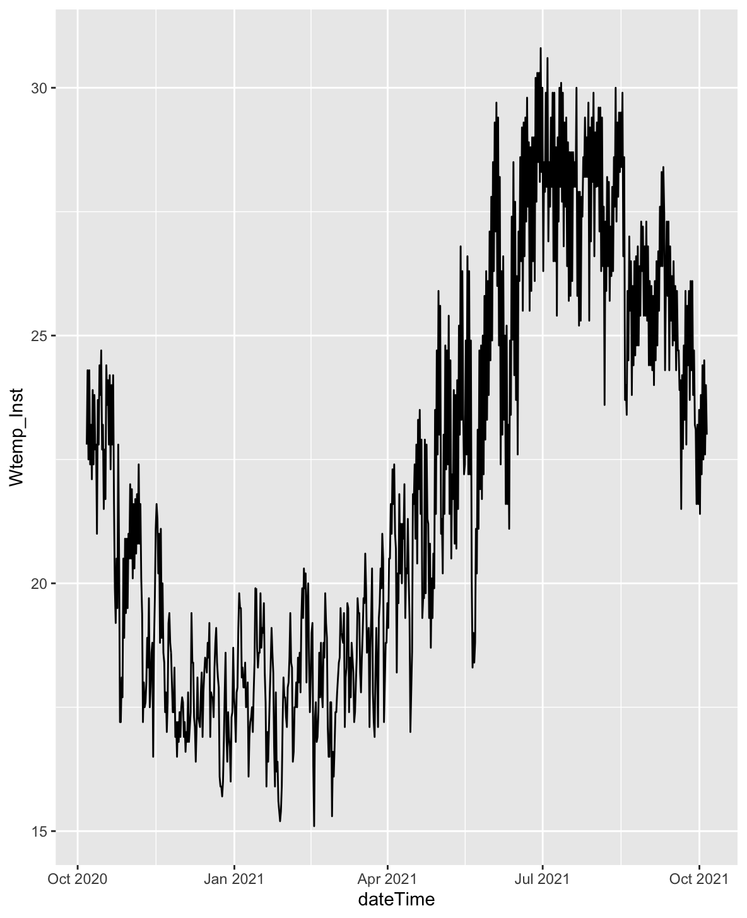
The Data, Pt 3 Rstudio: dataRetrieval
install.packages("dataRetrieval")
library(dataRetrieval)
vignette("dataRetrieval", package = "dataRetrieval")
pcode <- readNWISpCode("all")
?readNWISuv
siteNo <- "412044119121701"
pCode <- "00010"
start.date <- "2020-10-06"
end.date <- "2021-10-05"
DDSWTEMP_12 <- readNWISuv(siteNumbers = siteNo,
parameterCd = pCode,
startDate = start.date,
endDate = end.date)
DDSWTEMP_12 <- renameNWISColumns(DDSWTEMP_12)
names(DDSWTEMP_12)
View(DDSWTEMP_12)
ts <- ggplot(data = DDSWTEMP_12,
aes(dateTime, tz_cd)) +
geom_line()
ts

Slide 19


Slide 20
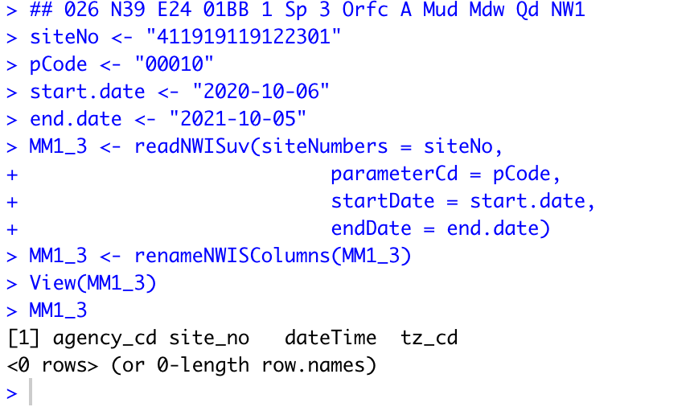
The Data, Pt 3 Rstudio: dataRetrieval
Limitations
Need to know the exact parameters a gauge is recording to pull the data using readNWISuv
Can’t pull multiple gauges files at once from the ID # or name, from the R code OR the website
What I want to do:
Give it a location/area and pull all data (or make a selection of data) from the gauges within a boundary/parameter from that area.
eg: give me all gauges within a 5 km radius of this point
OR: All gauges within this polygon/four corner shape

Slide 21
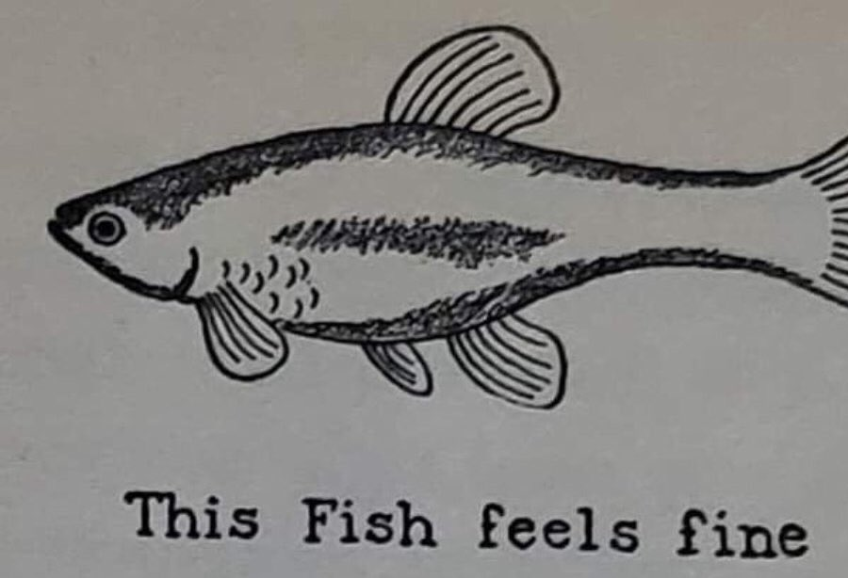

Slide 22
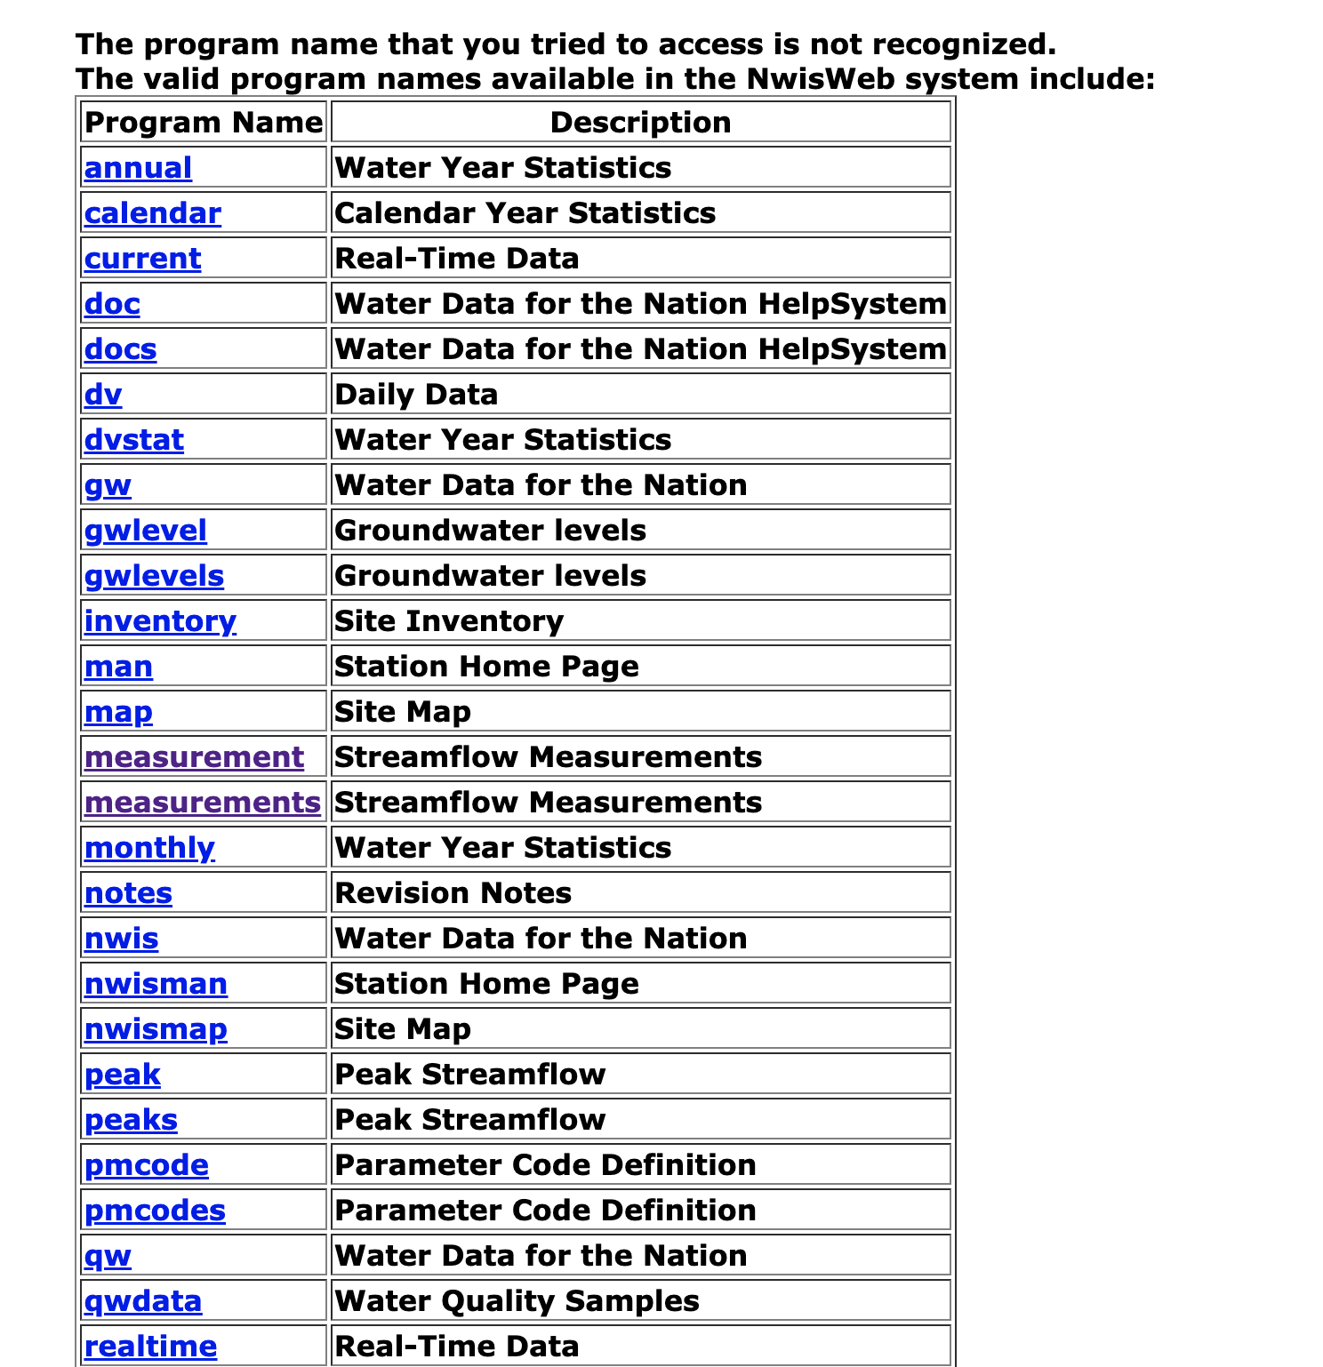
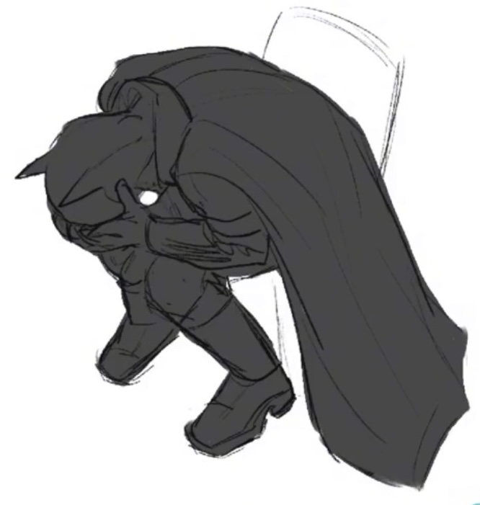
https://waterservices.usgs.gov/rest/IV-Test-Tool.html https://waterdata.usgs.gov/nwis/inventory?search_criteria=search_site_no&submitted_form=introduction

Slide 23


